Slide 1

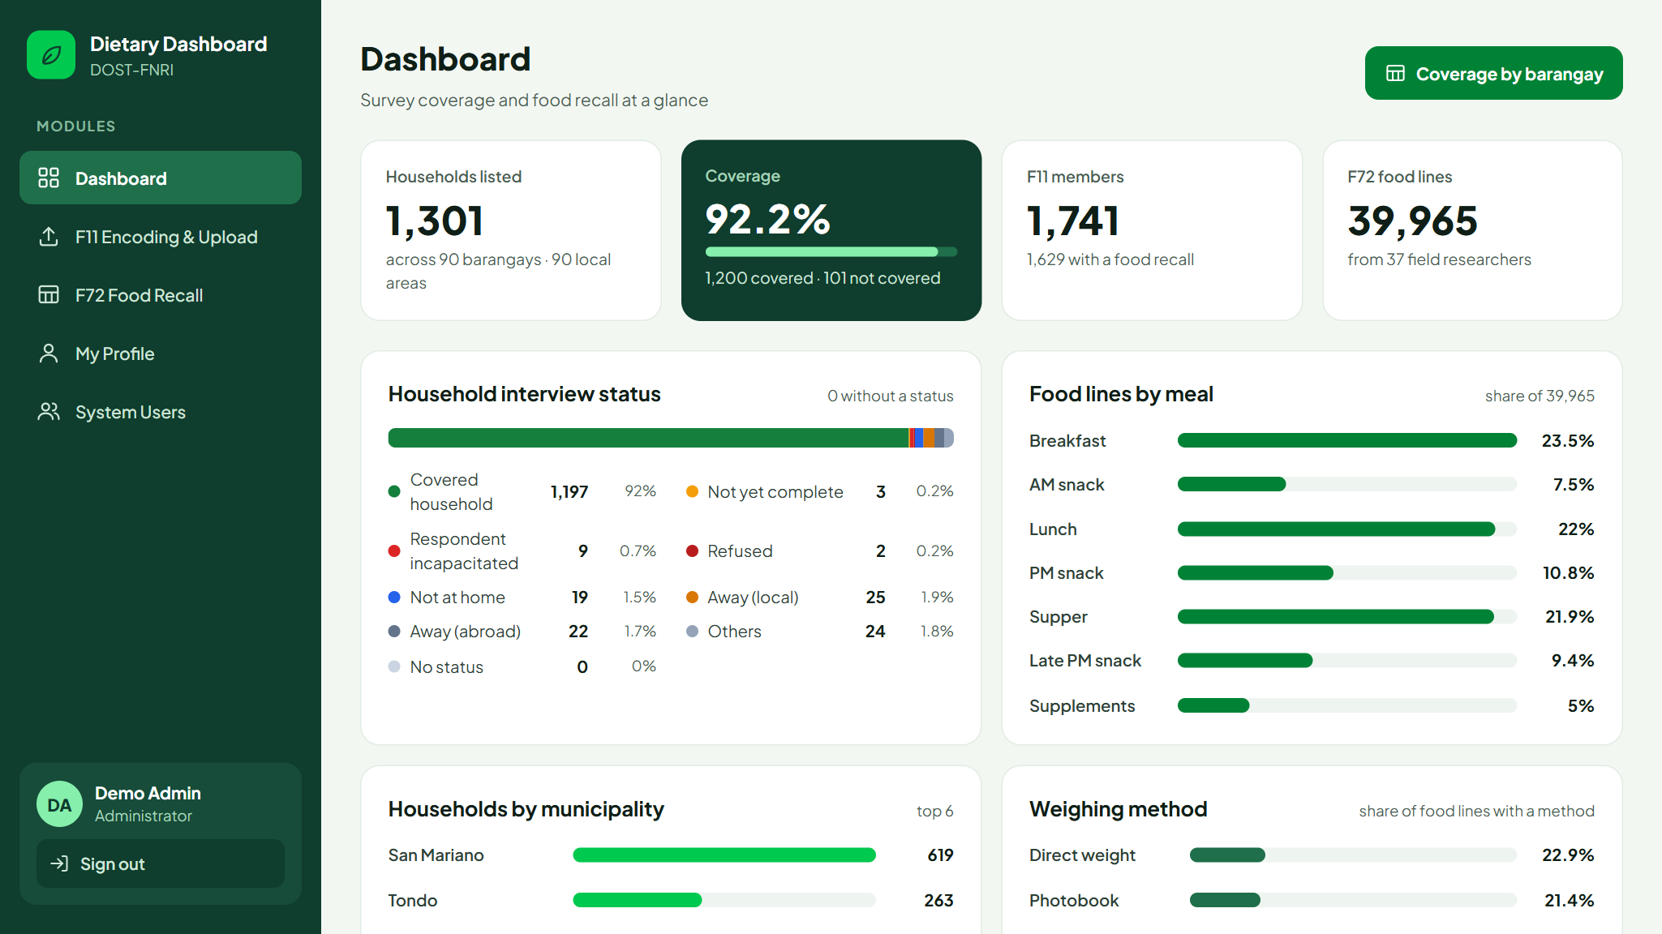
System navigation and user levels
Dietary Dashboard
DOST-FNRI
Dietary Dashboard · DOST-FNRI
How to get around the system and what each account level can open
Notes:
This deck walks through how to sign in, how the sidebar works, and which modules each account level - Administrator, Validator and Client - can open.

Slide 2



One system, three jobs
The Dietary Dashboard brings the DDCS survey data into one web system.
Dashboard
F11 Encoding and Upload
F72 Food Recall
See survey coverage, interview status, meals, weighing methods and researcher output at a glance.
Encode household members one at a time or upload them from the CSV template. Every change is tracked.
Review coverage by barangay, households, members recalled and food lines - and download the data.
Main users: Everyone
Main users: Validators
Main users: Clients
Notes:
Three jobs: the Dashboard for everyone, F11 for validators who encode members, and F72 for clients who review the food recall data. My Profile and System Users support these.

Slide 3



Three user levels
Administrator
Validator
Client
Project leads and system managers
Data validators and encoders
Data users and reviewers
Opens by default
Opens by default
Opens by default
Dashboard
F11 Encoding and Upload
F72 Food Recall
My Profile
System Users
Dashboard
F11 Encoding and Upload
My Profile
Dashboard
F72 Food Recall
My Profile
New registrations start as Client. Administrators set each account’s level in System Users.
Notes:
Administrator has everything including System Users. Validator gets F11 for encoding. Client gets F72 for reviewing. Everyone gets the Dashboard and My Profile. Anyone who registers starts as a Client.

Slide 4

Module access by level
Module | Administrator | Validator | Client | What it is for
Dashboard | ✓ | ✓ | ✓ | Survey-wide figures
F11 Encoding and Upload | ✓ | ✓ | — | Encode and upload household members
F72 Food Recall | ✓ | — | ✓ | Coverage, recalls and data downloads
My Profile | ✓ | ✓ | ✓ | Own details and password
System Users | ✓ | — | — | Accounts, levels and module access
These are the defaults. In System Users an administrator can switch any module on or off for one account - for example give a validator F72 too. System Users itself is for administrators only, and administrators always have every module.
Notes:
The checkmarks are the defaults per level. Access is per account, so an administrator can tick a module on or off for a single person without changing their level.

Slide 5
Getting in and getting around
Signing in, registering, and the sidebar every page shares

Slide 6
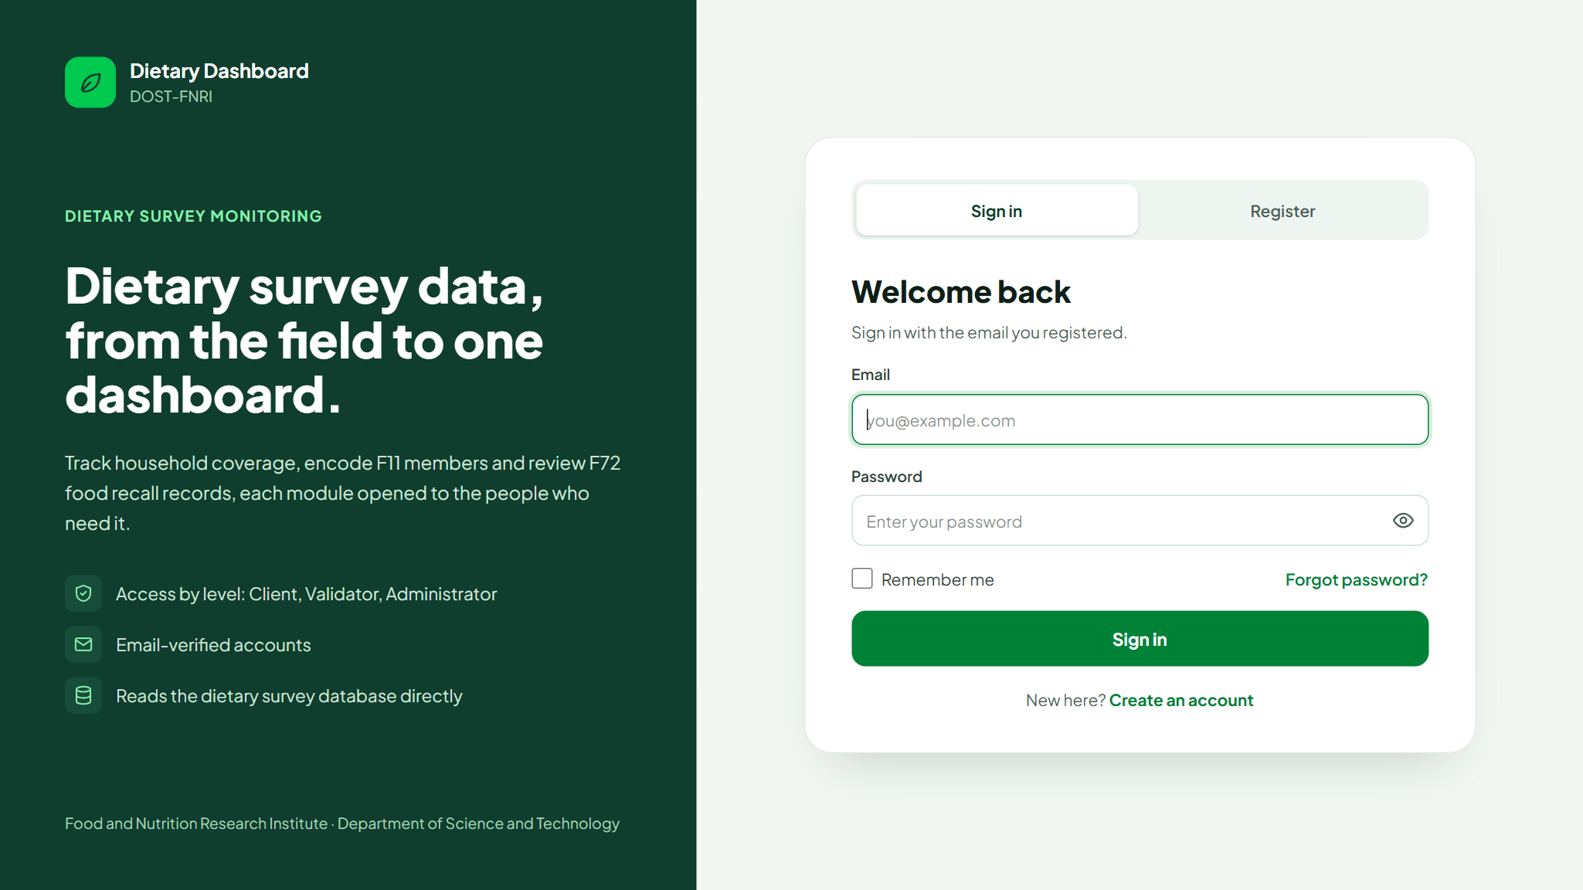
Signing in and registering
Sign in with your email and password. You land on your first module.
Register from the Register tab. New accounts are Clients.
Verify your email with the link sent to you before you can sign in.
Passwords need 8+ characters with upper and lower case, a number and a symbol.
Forgot password? sends a reset link to your email.
Notes:
Accounts created by an administrator get one welcome email with a link to set their own password. Five wrong sign-in attempts lock the email briefly.

Slide 7
Finding your way: the sidebar
1
Modules
3
4
1
Only what your account can open. The current page is highlighted.
2
Your account
Your name, level and the Sign out button.
3
Page header
What the page shows, in one line.
2
4
Page actions
Shortcuts such as Coverage by barangay or CSV template.
Notes:
On a phone the sidebar folds away behind the menu button at the top left.

Slide 8
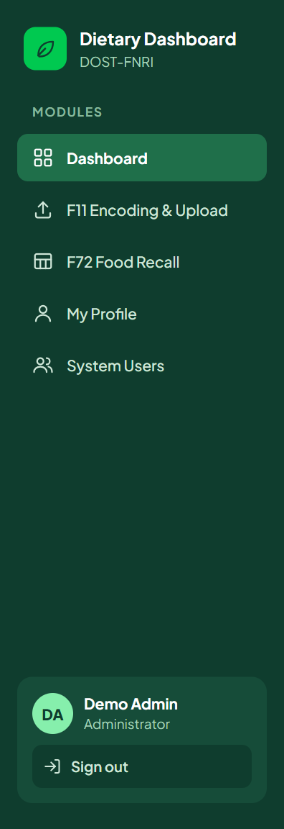
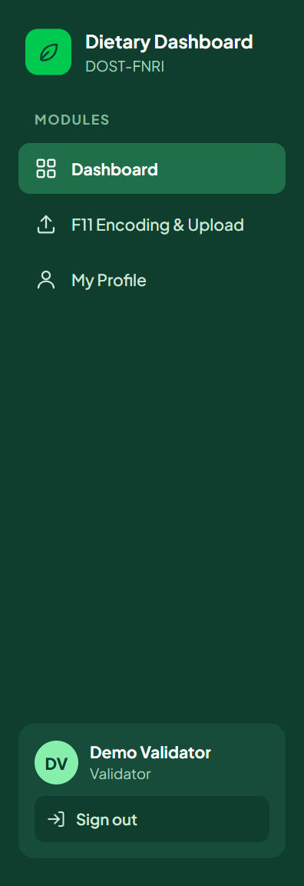
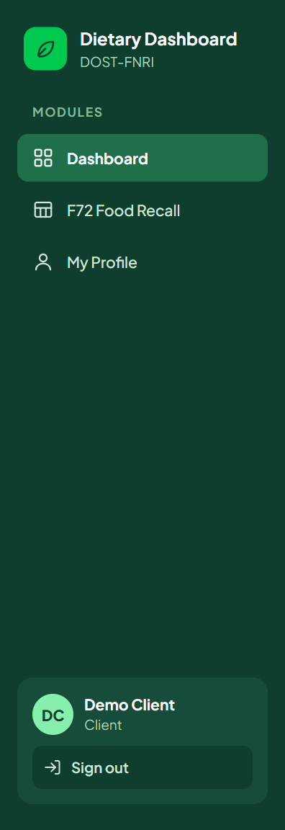
Each level sees its own sidebar
Administrator
Validator
Client
5
3
3
modules
modules
modules
Screenshots of the demo accounts: Demo Admin, Demo Validator, Demo Client.
Notes:
Typing the address of a module you do not have shows a 403 page - the sidebar is the reliable map of what you can open.

Slide 9
The modules
Dashboard · F11 Encoding and Upload · F72 Food Recall · My Profile · System Users

Slide 10
Dashboard
Administrator
Validator
Client
Headline figures: households, coverage, F11 members and F72 food lines.
Breakdowns: interview status, meals, weighing method, municipalities and top foods.
Researcher performance: day 1 and day 2 food lines per researcher, with search.
Coverage by barangay opens F72 for accounts that have it.
Notes:
The dashboard is the landing page for everyone and reads the whole survey.

Slide 11
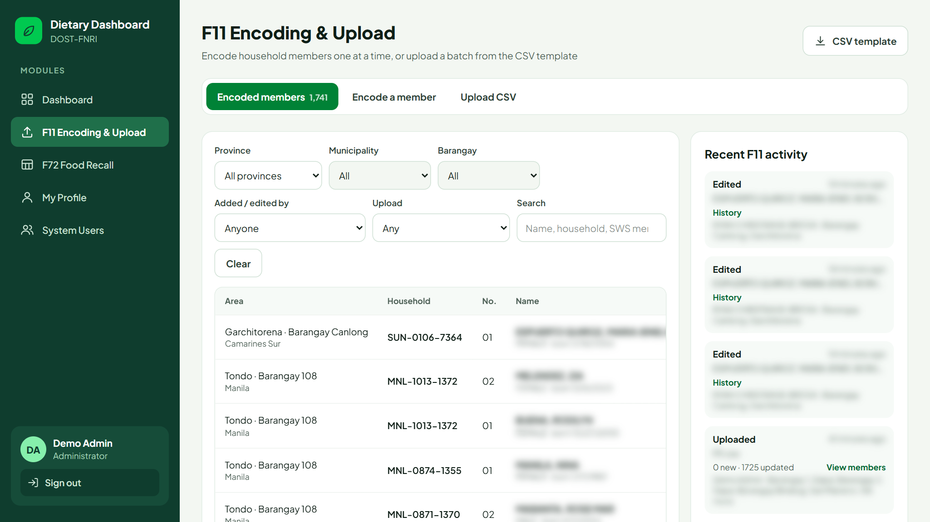
F11: encoded members
Administrator
Validator
Filter by area, by who added or edited, or by one upload.
See who added each member and who last edited it.
Edit to correct a record. Records are never deleted.
History shows every change, before and after.
Personal details are blurred in these screenshots.
Notes:
Members with no history are marked Field tablet - they came from the tablets and have not been changed in this system.

Slide 12
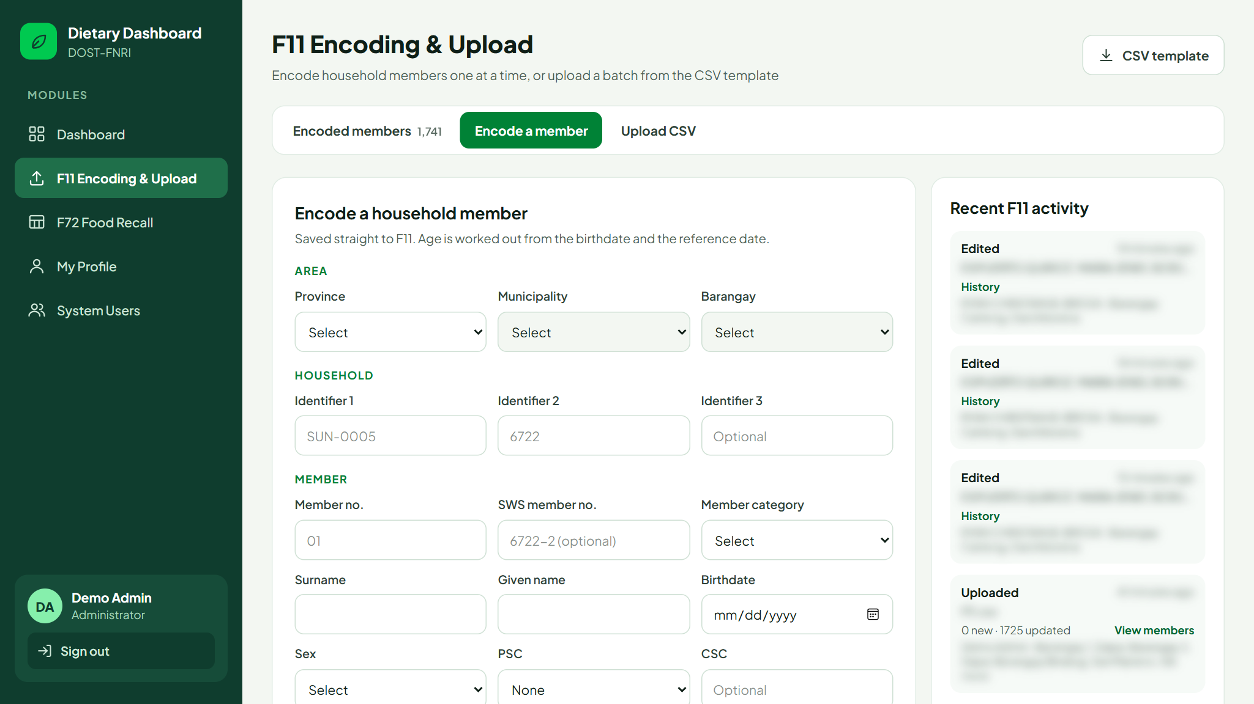
F11: encode a member
Administrator
Validator
Pick the area, then a listed household to fill in identifiers 1 to 3.
Age is worked out from the birthdate and reference date.
Saved as the tablets save it: names in capitals, member no. 01.
Duplicates are blocked: same area, household and member no.
Notes:
After saving, the area and household stay filled in so the next member of the same household is quicker to encode.

Slide 13





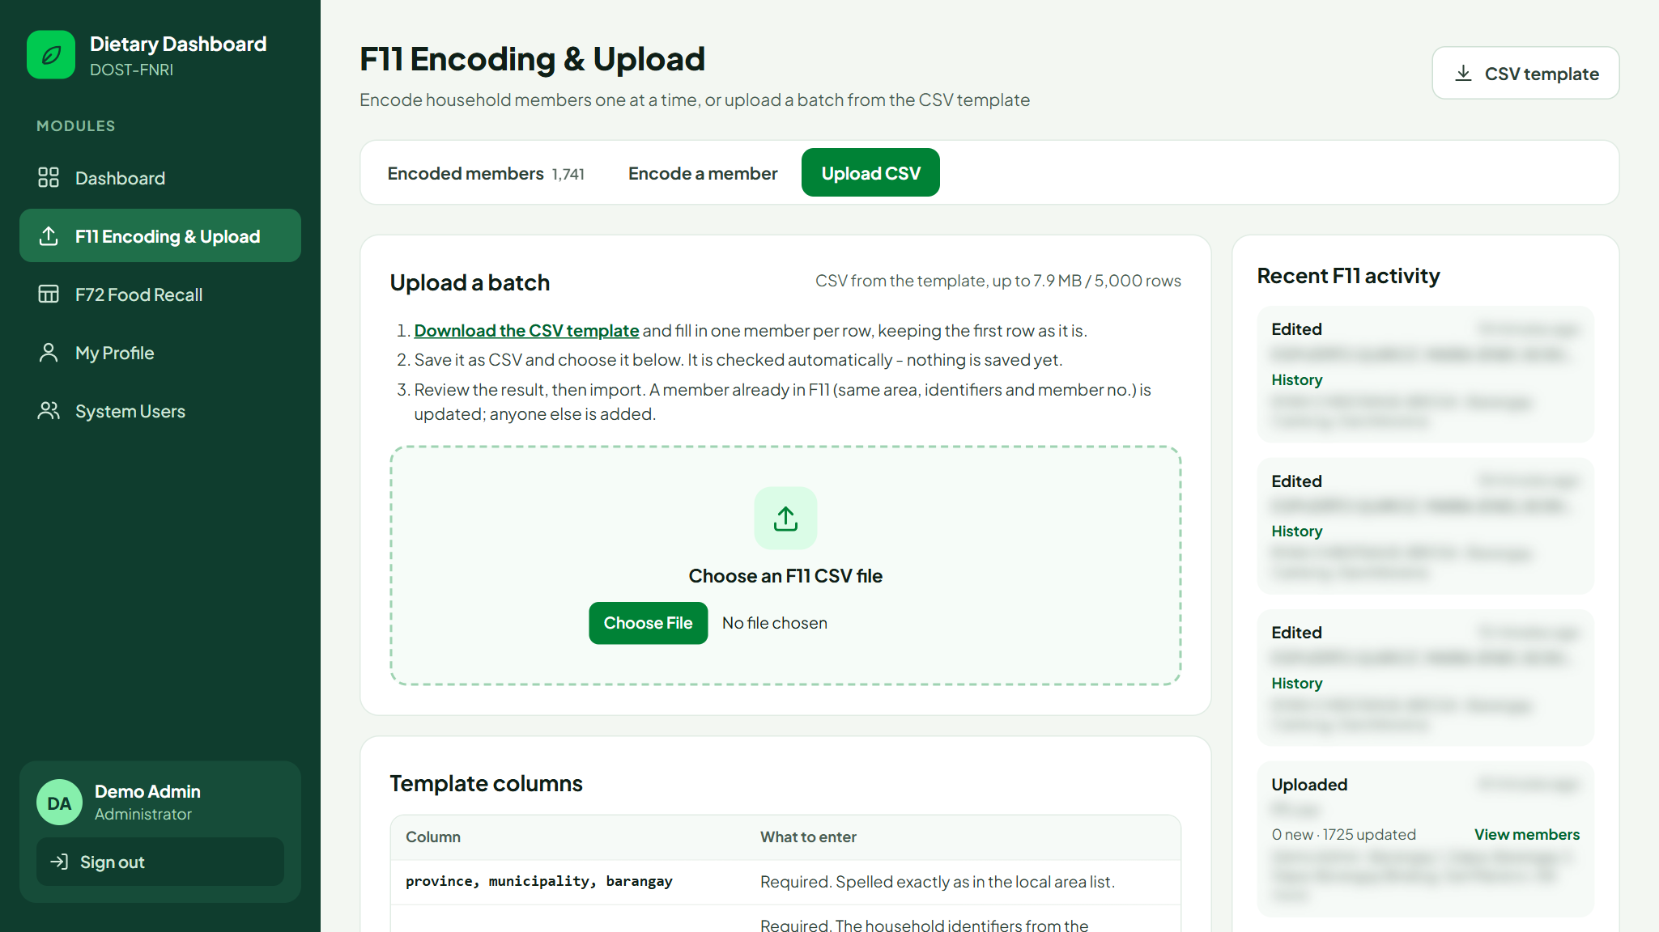
F11: upload a CSV batch
Administrator
Validator
1
2
3
4
Download the template
Fill one member per row
Choose the file
Review and import
CSV template button
Keep the first row
Checked automatically
New, updates, problems
The page shows the upload progress, then the check, then the result.
Rows with problems are listed by line and column and left out.
A member already in F11 is updated; anyone else is added.
Each upload is logged and its members can be listed again.
Notes:
Files can be up to the server limit shown on the page (currently about 8 MB) and 5,000 rows.

Slide 14
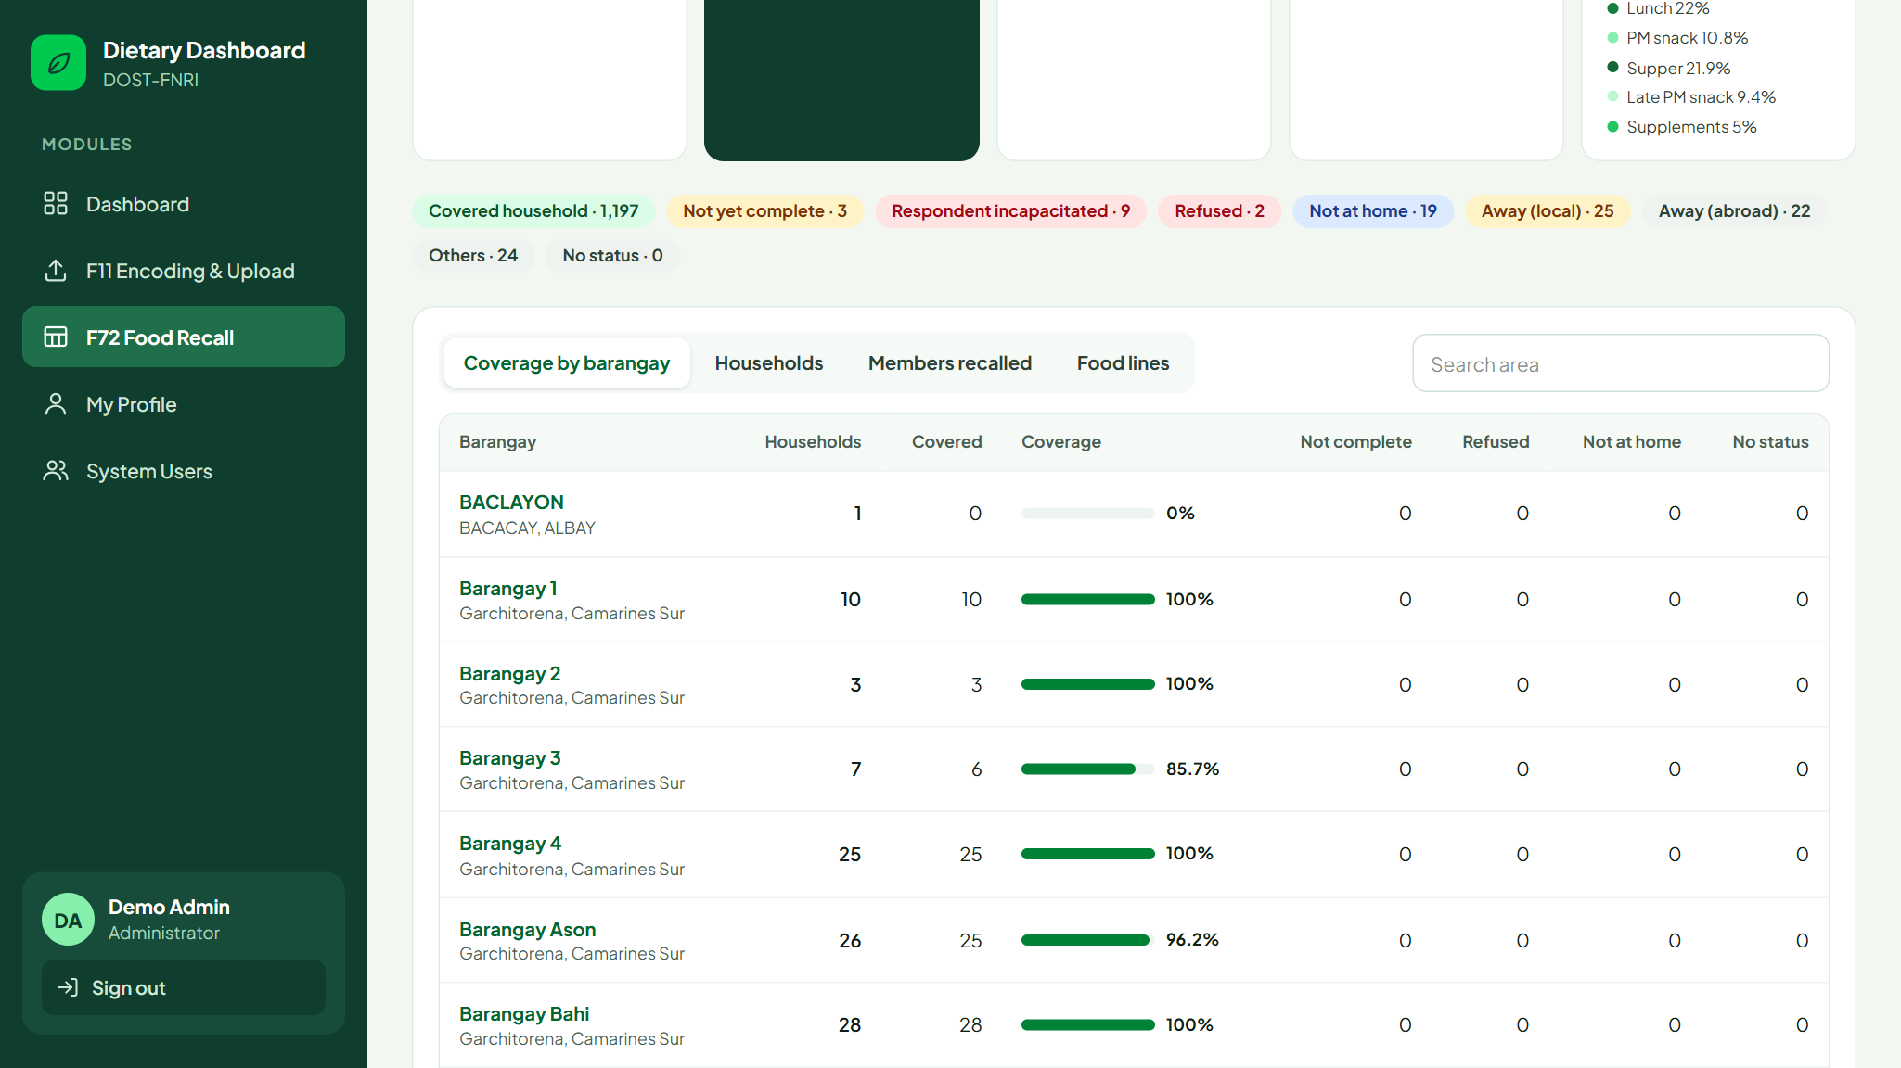
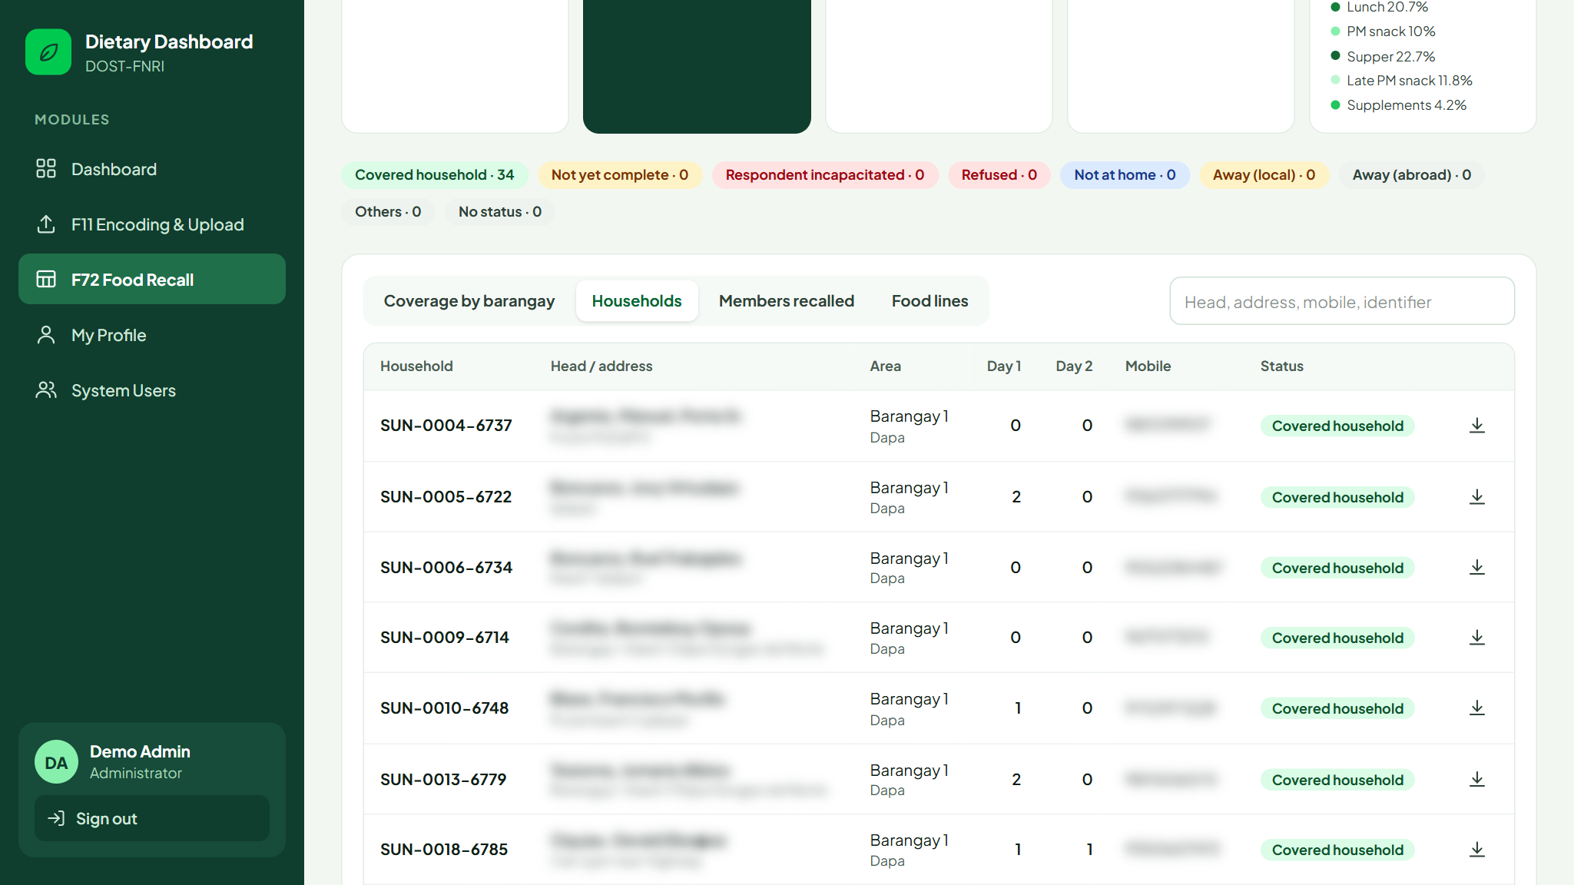
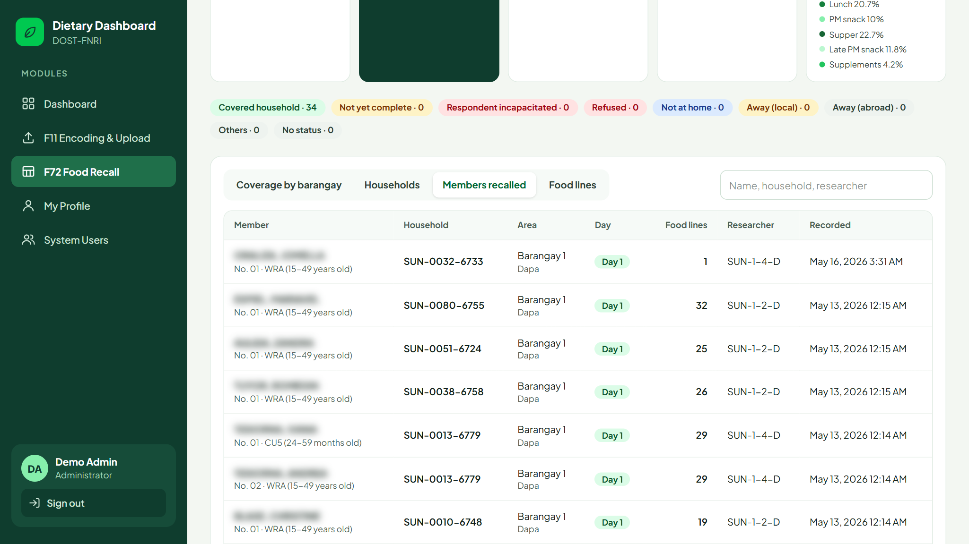
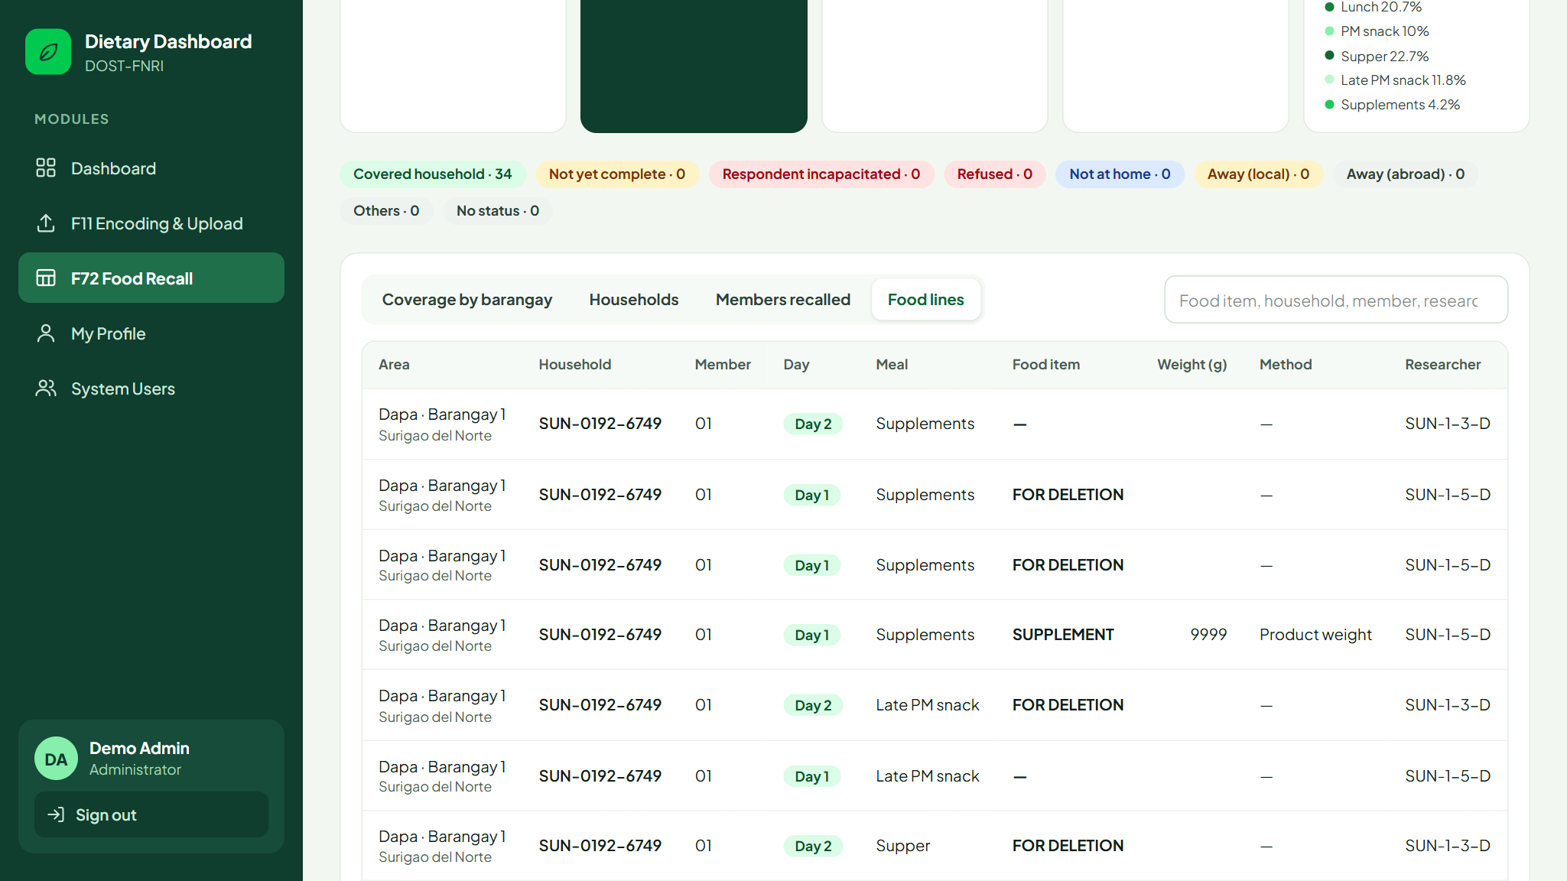
F72 Food Recall: four views
Administrator
Client
Coverage by barangay
Households
Click a barangay to open it
Day 1 and day 2 recalls, ZIP per household
Members recalled
Food lines
Names from F11, lines per day
Meal, food item, weight, method
Notes:
All four views share the filters at the top: province, municipality, barangay and recall day.

Slide 15
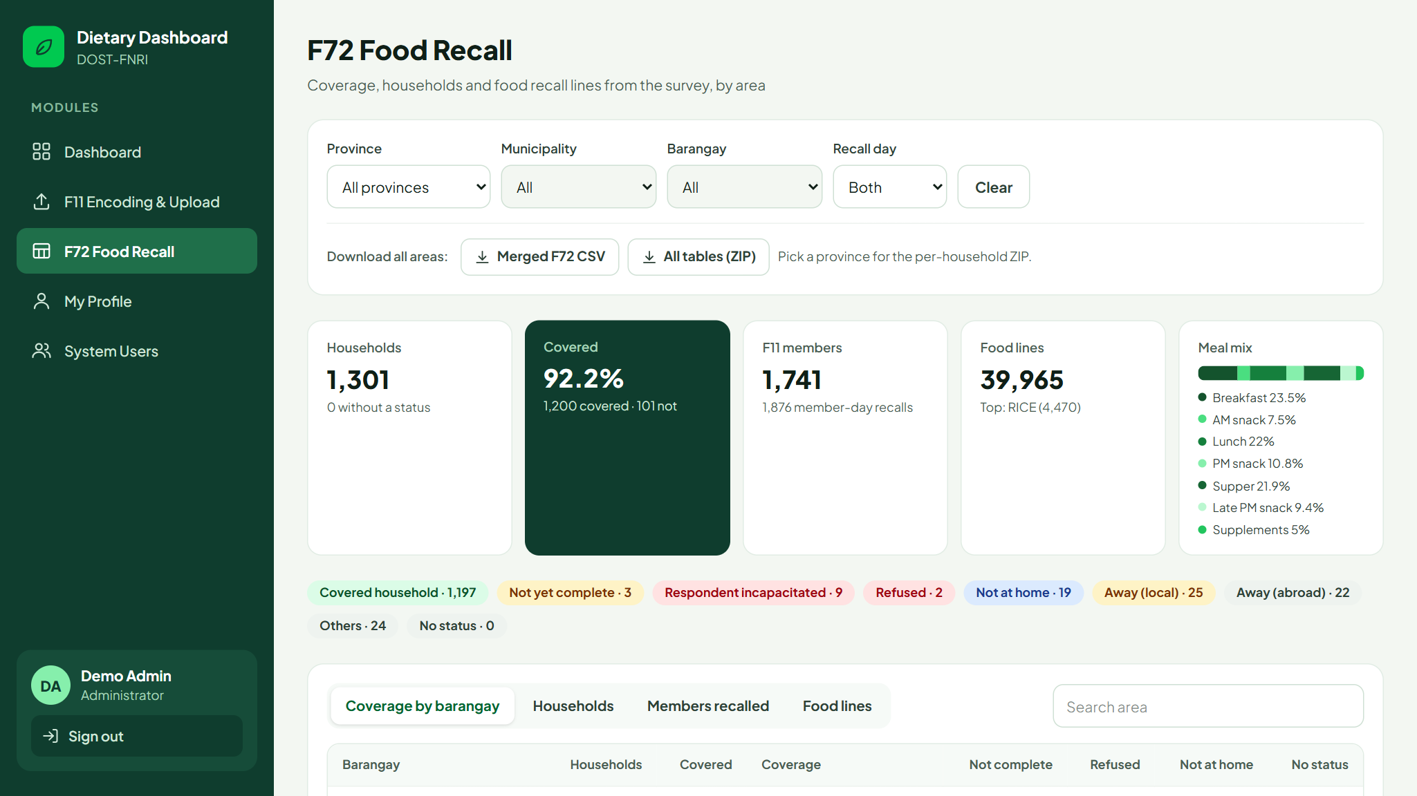



F72: downloads
Administrator
Client
Merged F72 CSV
One row per food line, with its household and F11 member beside it.
All tables (ZIP)
Every survey table as a CSV plus the merged report, for the filtered area.
Per barangay and household
Downloads follow the filters you have set. The household icon in the Households view downloads one household.
A folder per barangay with a folder per household. Pick a province first.
Notes:
These are the same files the old DDCS dashboard produced.

Slide 16
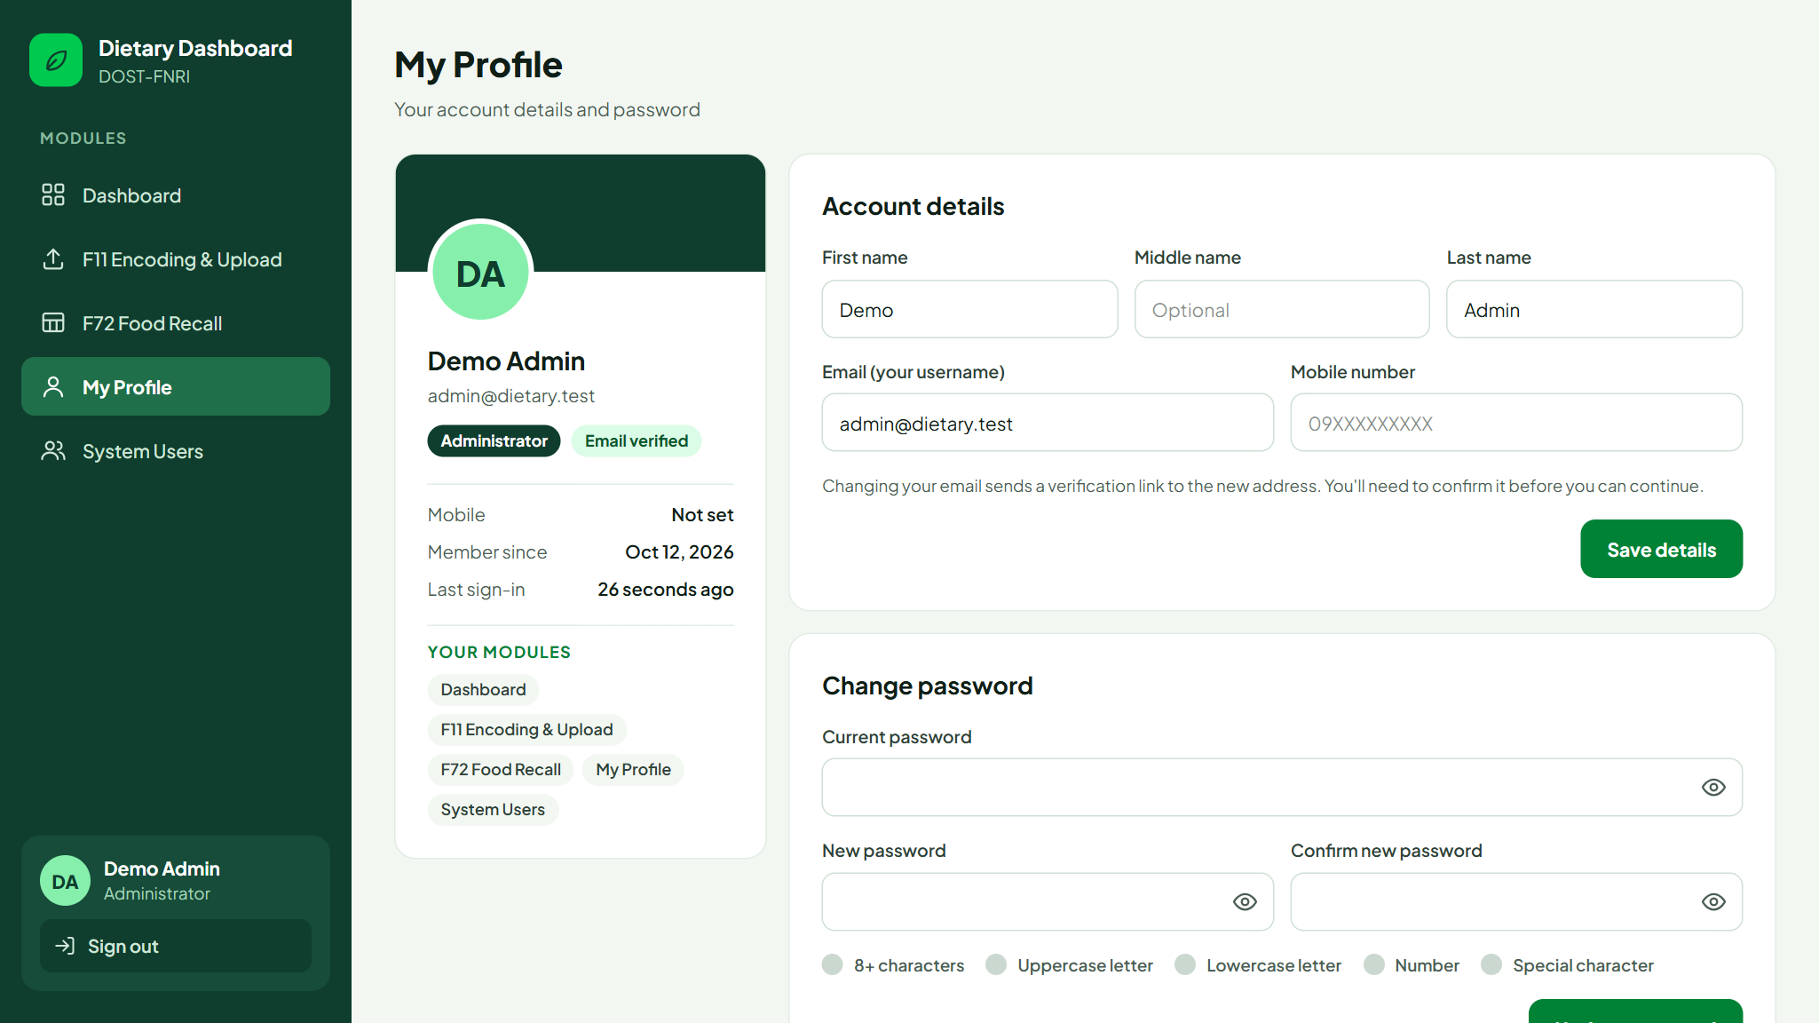
My Profile
Administrator
Validator
Client
Account details: name, email and mobile number.
Changing your email sends a new verification link.
Change password with your current password.
Your modules lists what your account can open.
Notes:
If someone needs another module, an administrator changes it in System Users.

Slide 17
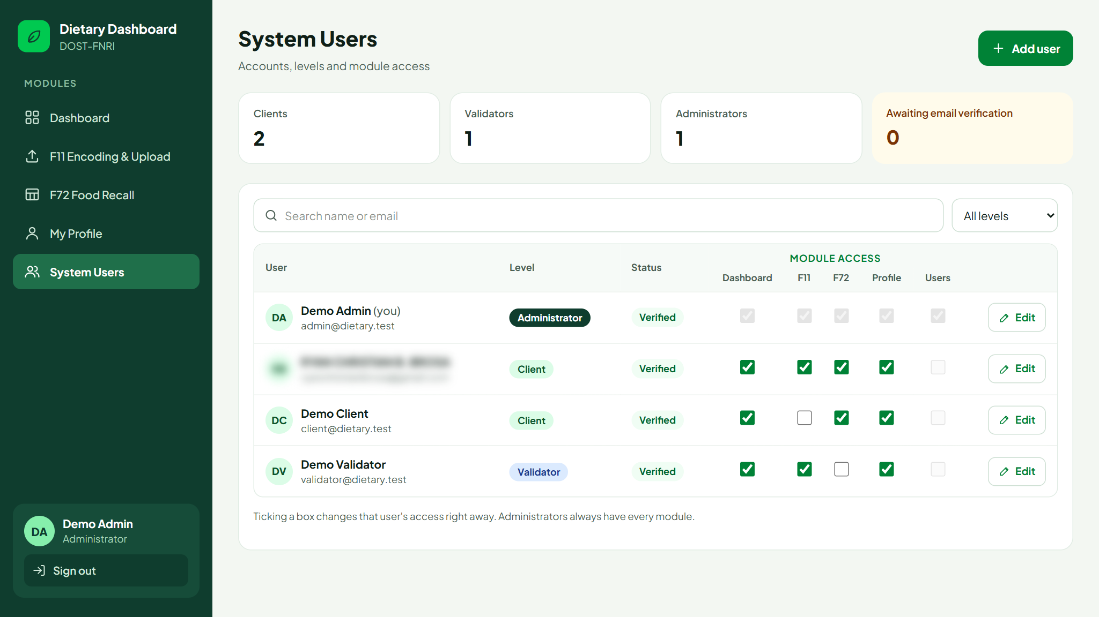
System Users
Administrator
Add user creates an account and emails a link to set a password.
Edit changes the name, level or active status.
Tick a module to open or close it for that account.
Filter by level and search by name or email.
Real accounts are blurred; the demo accounts are shown.
Notes:
Deactivating an account signs the person out on their next click.

Slide 18
Quick reference: where to go
I want to... | Go to | Who can
See overall coverage and figures | Dashboard | All levels
Encode a household member | F11 › Encode a member | Validator, Administrator
Upload many members at once | F11 › Upload CSV | Validator, Administrator
Check who changed a member | F11 › History | Validator, Administrator
Review a barangay’s households | F72 › Coverage by barangay | Client, Administrator
Download survey data | F72 › Download buttons | Client, Administrator
Change your password | My Profile | All levels
Give someone access | System Users | Administrator
Notes:
A one-page summary to keep at hand.

Slide 19
Questions?
Dietary Dashboard
DOST-FNRI
Need another module? Ask an administrator to update your access in System Users.

